Slide 1
딥러닝 이론 및 소프트웨어 구현 언어인지 개론
김중헌 교수 중앙대학교 소프트웨어학부 https://sites.google.com/site/joongheonkim/ joongheon@gmail.com
딥러닝기반 자연어처리 기초
텍스트분석 기초 및 KoNLPy
추천시스템 기초

Slide 2
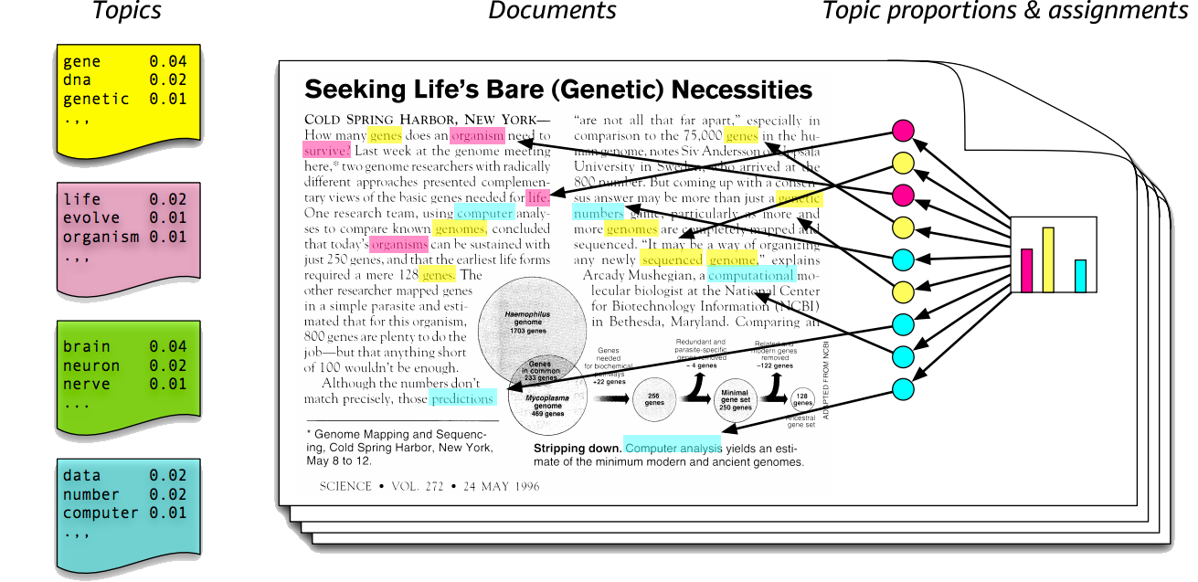
자연어처리 기초: Topic Modeling (Latent Dirichlet Allocation)
Topic Modeling (Latent Dirichlet Allocation)

Slide 3
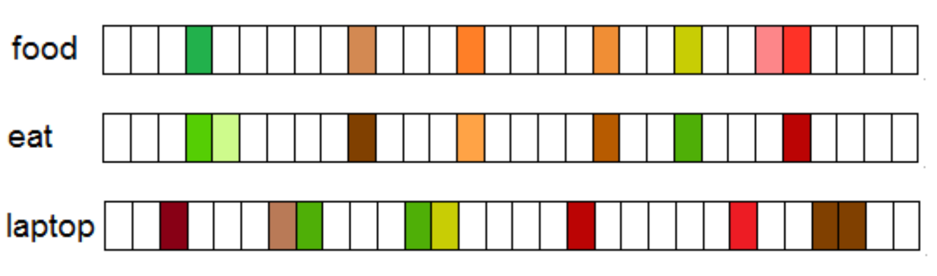
자연어처리 기초: Word Embedding
Word Embedding
Based on distributional hypothesis

Slide 4
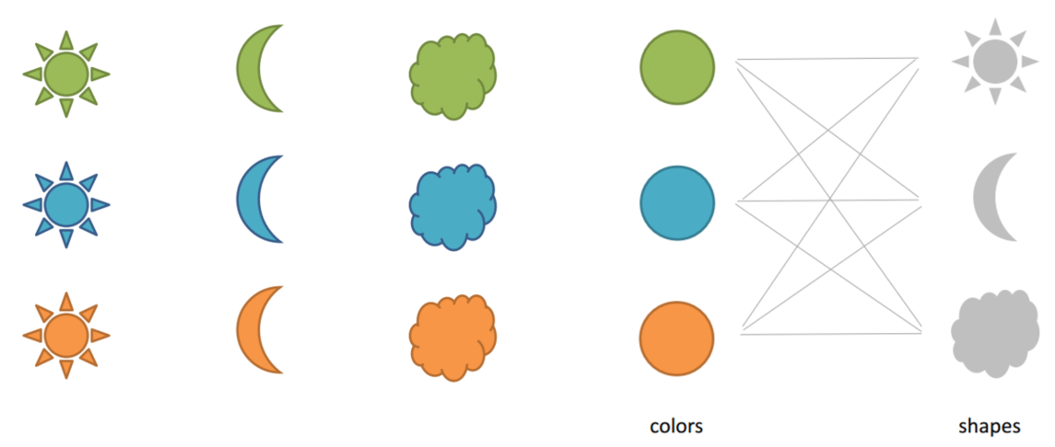
자연어처리 기초: Word Embedding
Word Embedding
Based on distributional hypothesis

Slide 5
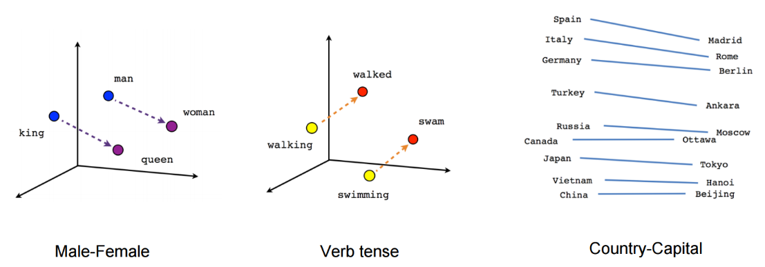
자연어처리 기초: Word Embedding
Word Embedding
Based on distributional hypothesis

Slide 6
자연어처리 기초: Word2Vec
What is encoding?
Convert text to number
Thank You
Love You
Unique word | Encoding
Thank | 0
You | 1
Love | 2

Slide 7
자연어처리 기초: Word2Vec
What is one hot encoding?
Convert text to vector
 | Thank | You | Love
Thank | 1 | 0 | 0
You | 0 | 1 | 0
Love | 0 | 0 | 1
Unique word | Encoding
Thank | [1,0,0]
You | [0,1,0]
Love | [0,0,1]

Slide 8
자연어처리 기초: Word2Vec
One hot encoding
However,
One hot encoding does not have similarity
Every distance is same to each other
Cosine similarity also 0 since angle is 90 degree
Unique word | Encoding
Thank | [1,0,0]
You | [0,1,0]
Love | [0,0,1]

Slide 9
자연어처리 기초: Word2Vec
Embedding
Embedding is dense vector with similarity
Unique word | Encoding | Embedding
King | [1,0,0,0] | [1,2]
Man | [0,1,0,0] | [1,3]
Queen | [0,0,1,0] | [5,1]
Woman | [0,0,0,1] | [5,2]

Slide 10
자연어처리 기초: Word2Vec
Definition of Word2Vec
Word2Vec is word embedding
Similarity comes from neighbor words

Slide 11
자연어처리 기초: Word2Vec
Word2Vec data generation (skipgram)
Windows size: 1
King Brave Man
Queen Beautiful Woman
Word | Neighbor
King | Brave
Brave | King
Brave | Man
Man | Brave
Queen | Beautiful
Beautiful | Queen
Beautiful | Woman
Woman | Beautiful

Slide 12
자연어처리 기초: Word2Vec
Word2Vec data generation (skipgram)
Windows size: 2
King Brave Man
Queen Beautiful Woman
Word | Neighbor
King | Brave
King | Man
Brave | King
Brave | Man
Man | King
Man | Brave
Queen | Beautiful
Queen | Woman
Beautiful | Queen
Beautiful | Woman
Woman | Queen
Woman | Beautiful

Slide 13
자연어처리 기초: Word2Vec
Word | Word (One-Hot) | Neighbor | Neighbor (One-Hot)
King | [1,0,0,0,0,0] | Brave | [0,1,0,0,0,0]
King | [1,0,0,0,0,0] | Man | [0,0,1,0,0,0]
Brave | [0,1,0,0,0,0] | King | [1,0,0,0,0,0]
Brave | [0,1,0,0,0,0] | Man | [0,0,1,0,0,0]
Man | [0,0,1,0,0,0] | King | [1,0,0,0,0,0]
Man | [0,0,1,0,0,0] | Brave | [0,1,0,0,0,0]
Queen | [0,0,0,1,0,0] | Beautiful | [0,0,0,0,1,0]
Queen | [0,0,0,1,0,0] | Woman | [0,0,0,0,0,1]
Beautiful | [0,0,0,0,1,0] | Queen | [0,0,0,1,0,0]
Beautiful | [0,0,0,0,1,0] | Woman | [0,0,0,0,0,1]
Woman | [0,0,0,0,0,1] | Queen | [0,0,0,1,0,0]
Woman | [0,0,0,0,0,1] | Beautiful | [0,0,0,0,1,0]
Word2Vec data generation (skipgram), window size: 2

Slide 14
자연어처리 기초: Word2Vec
Word | Word (One-Hot) | Neighbor | Neighbor (One-Hot)
King | [1,0,0,0,0,0] | Brave | [0,1,0,0,0,0]
King | [1,0,0,0,0,0] | Man | [0,0,1,0,0,0]
Brave | [0,1,0,0,0,0] | King | [1,0,0,0,0,0]
Brave | [0,1,0,0,0,0] | Man | [0,0,1,0,0,0]
Man | [0,0,1,0,0,0] | King | [1,0,0,0,0,0]
Man | [0,0,1,0,0,0] | Brave | [0,1,0,0,0,0]
Queen | [0,0,0,1,0,0] | Beautiful | [0,0,0,0,1,0]
Queen | [0,0,0,1,0,0] | Woman | [0,0,0,0,0,1]
Beautiful | [0,0,0,0,1,0] | Queen | [0,0,0,1,0,0]
Beautiful | [0,0,0,0,1,0] | Woman | [0,0,0,0,0,1]
Woman | [0,0,0,0,0,1] | Queen | [0,0,0,1,0,0]
Woman | [0,0,0,0,0,1] | Beautiful | [0,0,0,0,1,0]
Word2Vec data generation (skipgram), window size: 2
INPUT
OUTPUT

Slide 15
자연어처리 기초: Word2Vec
Word2Vec training (the first entry example → input: King, output: Brave)
Input
Hidden
Output
1
0
0
1
King
0
w1
0
Brave
0
w2
0
0
0
0
0

Slide 16
자연어처리 기초: Word2Vec
Word2Vec testing
Input
Hidden
Output
1
0.1
0
0.9
argmax
King
0
w1
0
Brave
0
w2
0
0
0
0
0

Slide 17
자연어처리 기초: Word2Vec
Word2Vec
Input
Hidden
Output (softmax)
1
0.1
0
0.9
Unique Word | Embedding (w1,w2)
King | [1,1]
Brave | [1,2]
Man | [1,3]
Queen | [5,4]
Beautiful | [5,5]
Woman | [5,6]
King
0
w1
0
0
w2
0
0
0
0
0

Slide 18
딥러닝 이론 및 소프트웨어 구현 언어인지 개론
김중헌 교수 중앙대학교 소프트웨어학부 https://sites.google.com/site/joongheonkim/ joongheon@gmail.com
딥러닝기반 자연어처리 기초
텍스트분석 기초 및 KoNLPy
추천시스템 기초

Slide 19

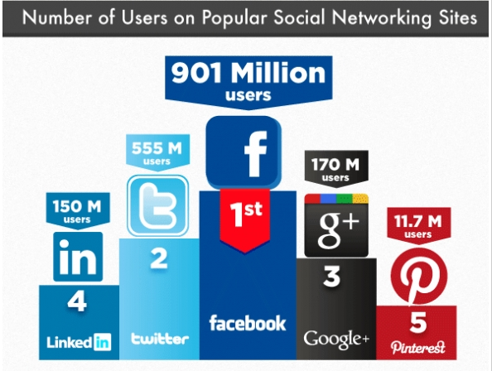
텍스트분석 기초

Slide 20
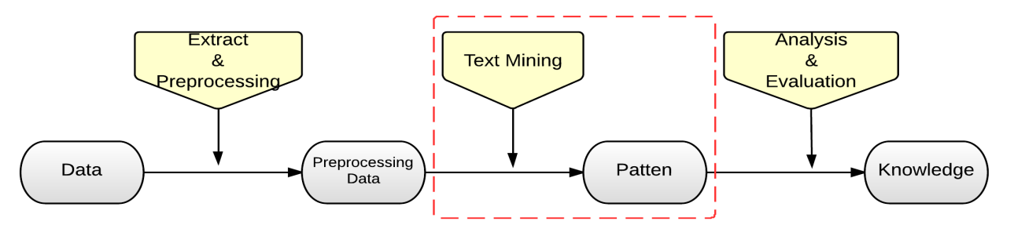
텍스트분석 기초
Text Mining Procedure
Document
collection
1
Establish the Corpus : Collect and organize the domain-specific data
Corpus
2
Feedback
Pre-process the Data:
Introduce structure to the corpus
Patterns & Associations
Structured
data
3
Feedback
Extract knowledge:
Discover patterns from the preprocessed data
Feedback : adjustment / corrections

Slide 21
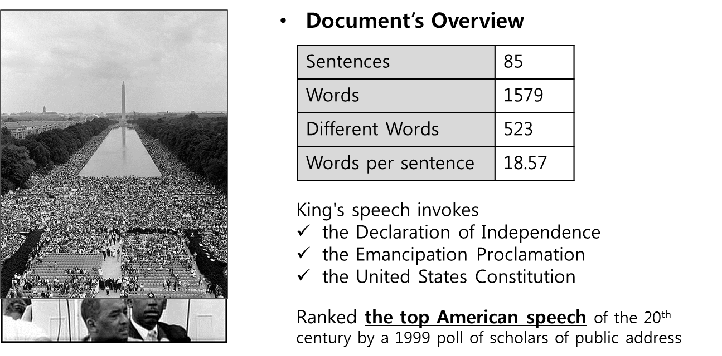
텍스트분석 예제
“I Have a Dream” by Martin Luther King

Slide 22
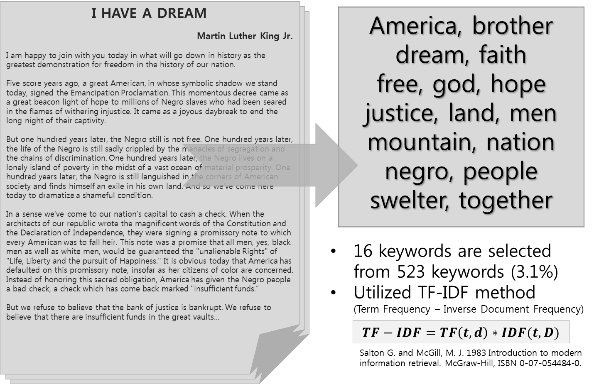
텍스트분석 예제
Keywords

Slide 23
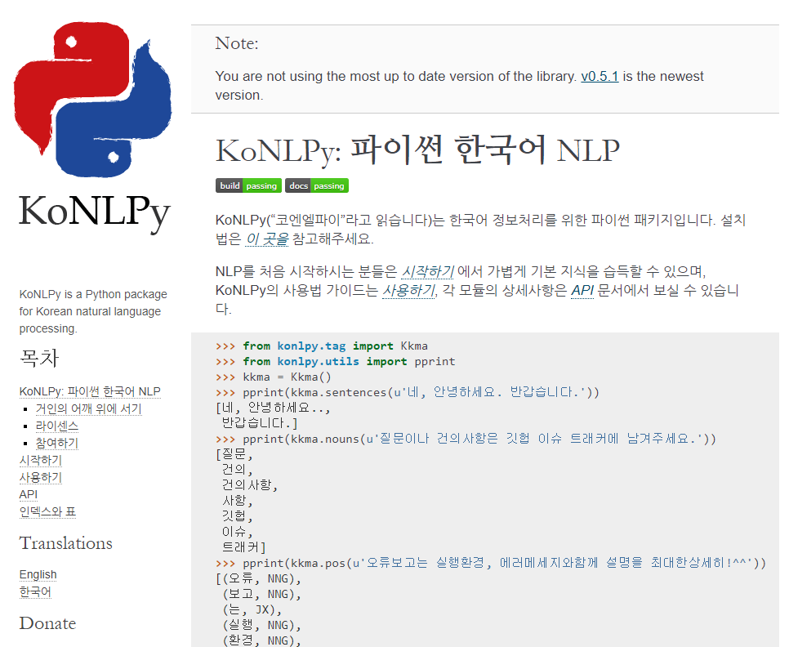
KoNLPy 소개
KoNLPy
https://konlpy-ko.readthedocs.io/
한국어 정보처리를 위한 파이썬 패키지

Slide 24
설치법
설치 명령어
pip install konlpy
sudo apt-get install openjdk-8-jdk

Slide 25
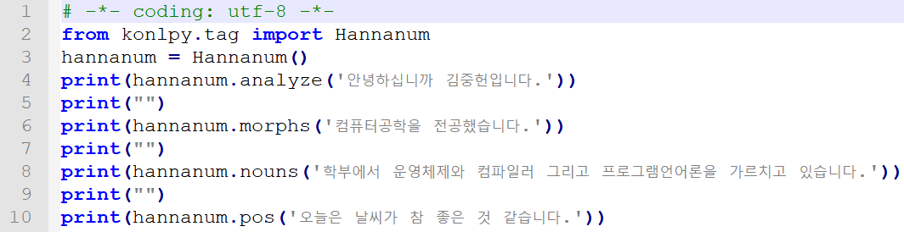
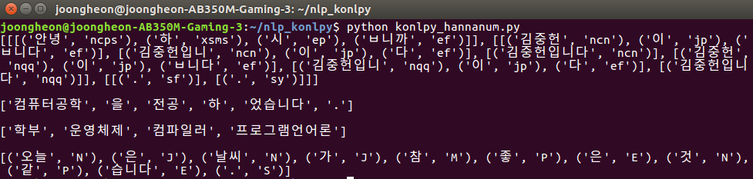
KoNLPy (Hannanum)

Slide 26
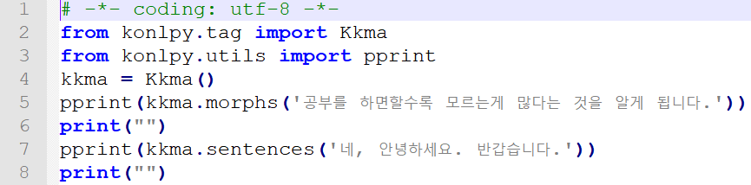
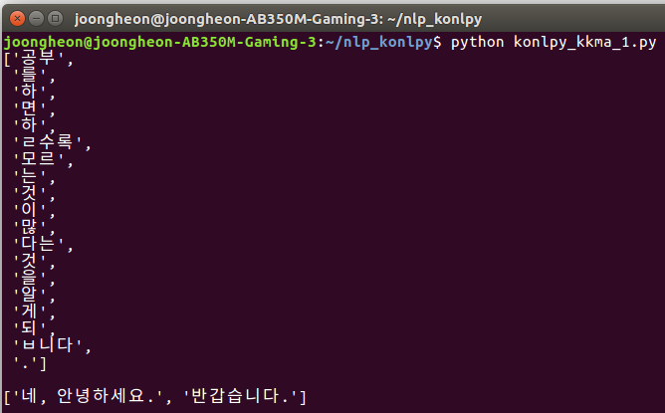
KoNLPy (Kkma)

Slide 27
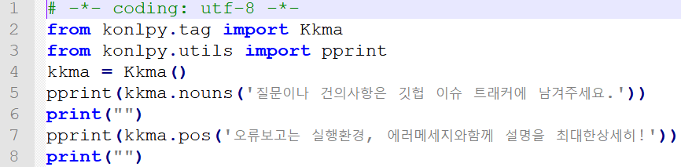
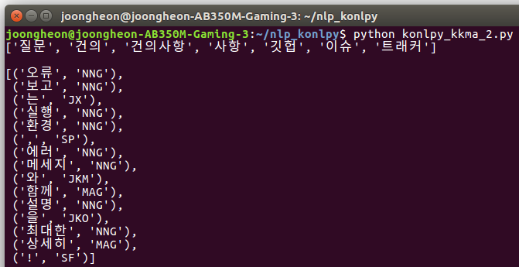
KoNLPy (Kkma)

Slide 28
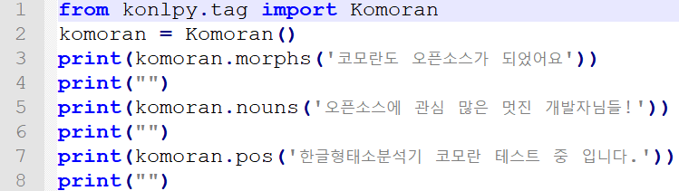
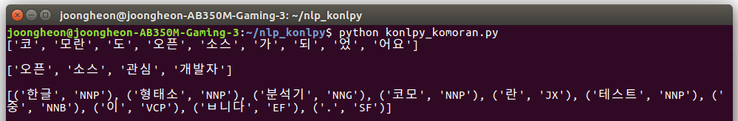
KoNLPy (Komoran)

Slide 29
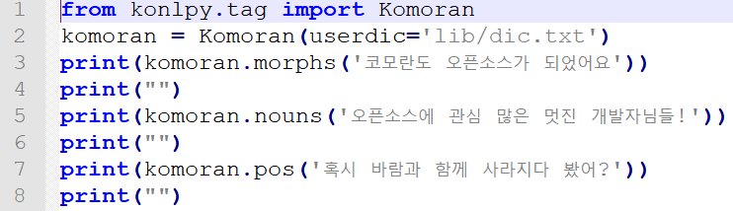
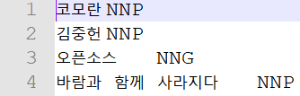
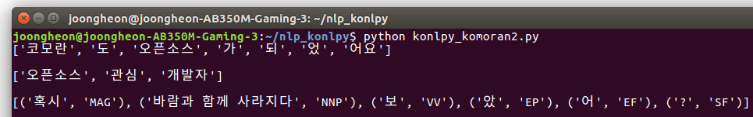
KoNLPy (Komoran)
lib/dic.txt

Slide 30
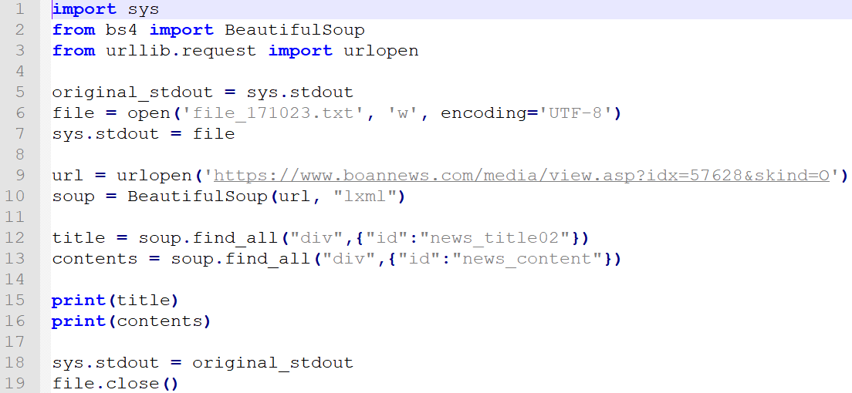
KoNLPy, 인터넷 뉴스 가져오기 (1)

Slide 31
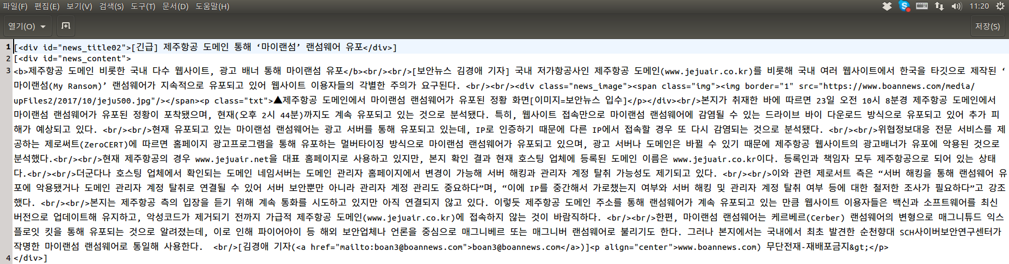
KoNLPy, 인터넷 뉴스 가져오기 (1)

Slide 32
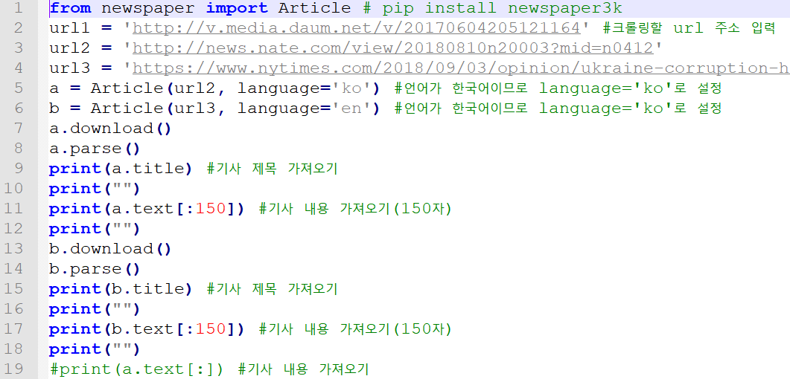
KoNLPy, 인터넷 뉴스 가져오기 (2)

Slide 33
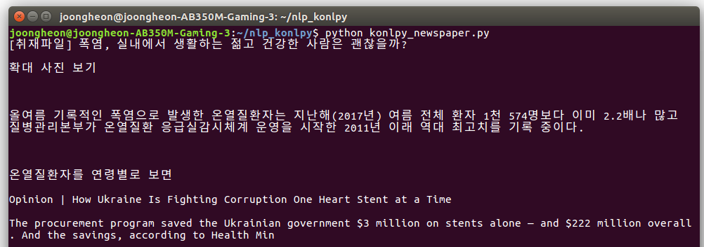
KoNLPy, 인터넷 뉴스 가져오기 (2)

Slide 34
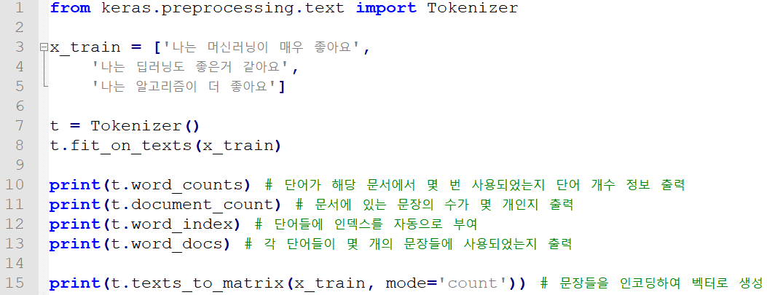
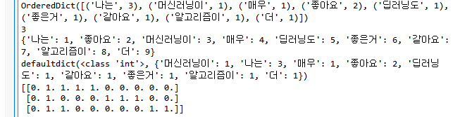
Keras 활용

Slide 35
딥러닝 이론 및 소프트웨어 구현 언어인지 개론
김중헌 교수 중앙대학교 소프트웨어학부 https://sites.google.com/site/joongheonkim/ joongheon@gmail.com
딥러닝기반 자연어처리 기초
텍스트분석 기초 및 KoNLPy
추천시스템 기초

Slide 36
추천시스템 기초: 정의
Recommendation System
Based on the user’s behavior activity, relations, item similarity, and user contexts, realizing the automated estimation of user preferred items.
Search
Review Scores
User Behavior Activity Log
Click
Payment
Cart
Purchase

Slide 37
추천 알고리즘 개요
Amazon Recommendation System A9
Personalized Recommendation via Item Similarity DB

Slide 38
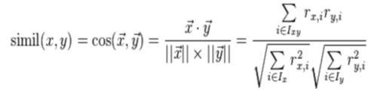
추천시스템 기초: Collaborative Filtering
Collaborative Filtering (CF)
Based on the behavior activity log, conducting the mining of purchase patterns
Measuring the similarity for (i) user-to-user, (ii) item-to-item, and (iii) user-to-item
Similarity measure via cosine similarity
(Step 1) Check the purchased item
(Step 2) Find the similar items via the cosine similarity
(Step 3) Make a recommendation for the similar items

Slide 39
추천시스템 기초: Collaborative Filtering
Collaborative Filtering (CF)
Pros
Implementable with small number of information
Reasonable accuracy are reported in practical applications
Cons
Use of low-density high-dimensional vectors
Scalability issue: handling newly added users/items is not easy with CF

Slide 40
추천시스템 기초: Content-based Filtering
Content-based Filtering (CF)
Recommendation based on item-attributes
Analyzing the item itself whereas collaborative filtering focuses on user behavior activity logs
Since item-attribute is the core of this algorithm, conducting item analysis and item-similarity measure is important. → TF-IDF method is used.

Slide 41
추천시스템 기초: Collaborative Filtering vs. Content-based Filtering
Collaborative Filtering vs. Content-based Filtering (CF)
 | Collaborative Filtering | Content-based Filtering
장점 | 대부분의 경우 추천성능이 좋음 잠재적인 특징을 고려, 보다 다양한 범위의 추천 가능 | 사용자의 기호를 직접 반영 새로 추가된 아이템도 추천 가능
단점 | 아직 평가되지 않은 항목은 추천대상으로 발견되기 어려움 초기 사용자에 대해선 믿을만한 추천이 어려움 | 명시적으로 표현된 특징만을 다룰 수 있고 질적 부분을 포착하기 어려움 사용자의 선호도/취향을 특정 단어로 표현하기 어려움 추천하는 항목이 비슷한 장르에 머무르는 한계 존재

Slide 42
추천 알고리즘 개요
Collaborative Filtering vs. Content-based Filtering (CF)
Collaborative Filtering
다수 사용자의 평가 정보 활용
다양한 범위의 추천 가능
사용자 행동로그 등 빅데이터 활용
Content-based Filtering
아이템 설명 정보 활용
적은 데이터로 추천 가능
좁은 범위 추천
다양한 범위 추천 가능
새로 추가된 아이템 추천 가능
유사성, 잠재요소 등을 고려하여
두 알고리즘과 딥러닝의 특징을 결합한 추천 알고리즘 개발

